Slide 1
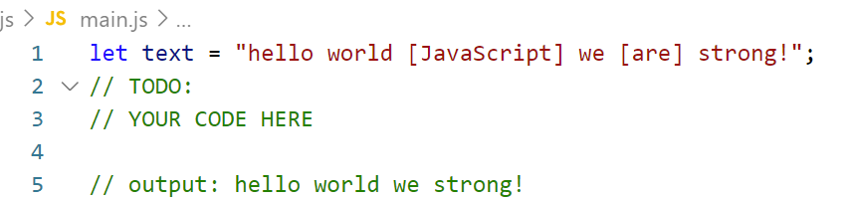
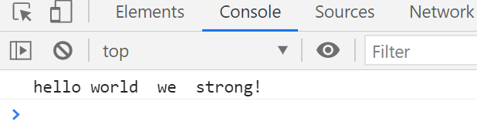
Exercise 1
Write code to get the only text outside brackets [ ] from paragraph.
Step:
1. Open exercises folder in Vscode
2. Run index.html file
3. Open Console on browser ( Ctrl + shift + i)
4. Open main.js file and write your JavaScript code
Example:
Input:
hello [2021] JS
Output:
hello JS

Slide 2
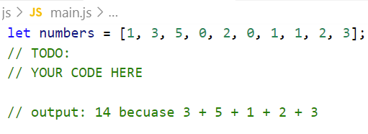
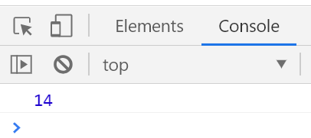
Exercise 2
Write code to sum number after number 1 until number 0.
Step:
1. Open exercises folder in Vscode
2. Run index.html file
3. Open Console on browser ( Ctrl + shift + i)
4. Open main.js file and write your JavaScript code
Example:
Input:
[0, 1, 1, 3, 4]
Output:
8
Because 1 + 3 + 4

Slide 3
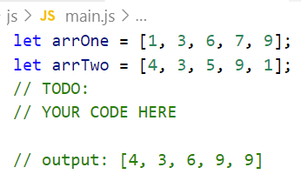
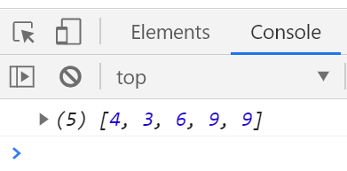
Exercise 3
Write code to find maximum of two array.
Step:
1. Open exercises folder in Vscode
2. Run index.html file
3. Open Console on browser ( Ctrl + shift + i)
4. Open main.js file and write your JavaScript code
Example:
Input:
[2, 4, 6]
[3, 1, 0]
Output:
[3, 4, 6]
Because :
2 < 3 => add 3 to new array
4 > 1 => add 4 to new array
6 > 0 => add 6 to new array

Slide 4
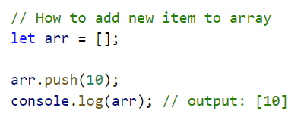
Help!
More details:
https://www.w3schools.com/jsref/jsref_push.asp

Slide 5
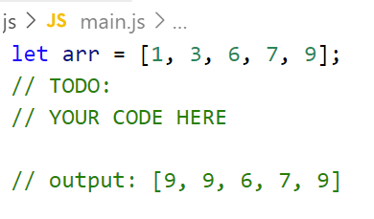
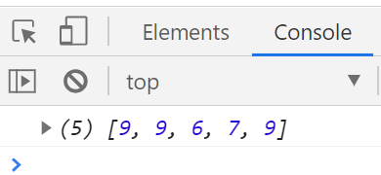
Exercise 4
Write code to find maximum number and replace all number
that less than 5 with maximum number.
Step:
1. Open exercises folder in Vscode
2. Run index.html file
3. Open Console on browser ( Ctrl + shift + i)
4. Open main.js file and write your JavaScript code
Example:
Input: [1, 2, 7, 5, 8]
Output: [8, 8, 7, 5, 8]
Because :
1 < 5 => replace with 8
2 < 5 => replace with 8
7 > 5 => keep the same value
5 < 5 => keep the same value
8 > 5 => keep the same value

